Slide 1

Neural Networks
Jasamrit Rahala
JRahala

Slide 2
Agenda
Why use neural networks?
When and where are they used?
Types of problems
The Perceptron
XOR Network
Feedforward networks
Backpropagation

Slide 3
Types of problems
Neural networks are known for their scope and ability to adapt to different situations.
Image classification
Forecasting
Speech recognition (NMT)

Slide 4
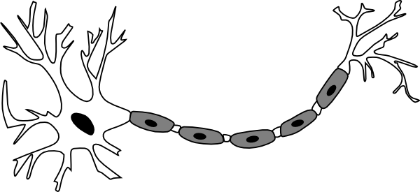
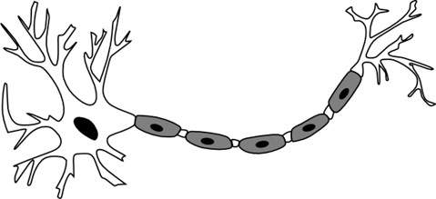
Theory Neurons Dendrons Axons
The human brain contains 86 billion neurons
Our network will contain below 10
Neural networks try to replicate the neuron, specifically the passing of signals within a network.

Slide 5
Theory Structure
There are three main components of a basic NN.
The input layer
The hidden layer(s)
The output layer
Nodes / Neurons
Edges / Connections

Slide 6
Theory Structure
There are three main components of a basic NN.
The input layer
The hidden layer(s)
The output layer
Data is passed in: images / numbers

Slide 7
Theory Structure
There are three main components of a basic NN.
The input layer
The hidden layer(s)
The output layer
Data is evaluated and ‘fed forward’

Slide 8
Theory Structure
There are three main components of a basic NN.
The input layer
The hidden layer(s)
The output layer
Data is evaluated and ‘fed forward’

Slide 9
Theory Structure
There are three main components of a basic NN.
The input layer
The hidden layer(s)
The output layer
An output is produced, this is followed can be followed by training

Slide 10
Theory Simple patterns & problems
Everything in a neural network has some effect on everything else. The principle components of a neural network are neurons.
1.5
0.7
Σ
0.6
1.5
0.2
0.7 + 0.6 + 0.2

Slide 11
Theory Weighted neurons
Lets use the example of estimating the likelihood of cancer given features of an suspected mole.
Diameter of mole
Colour of mole
Asymmetry
Certain inputs like diameter may have more significance to the output of the NN therefore we can weight certain connections.

Slide 12
Theory Weighted Neurons
The connections that link together nodes can help increase / decreases the effect of a certain neuron. Connections contain weights, these weights are multiplied by nodes output when feeding information forward.
0.35
0.7
0.5
1.05
1
0.7
0.70

Slide 13
Theory Types of problems
Linking the concepts we have just learnt, we can produce a functional node. Our node will be able to multiply a number by 2
Input 1 | Output
1 | 2
2 | 4
3 | 6
4 | 8
2i₁
i₁
2

Slide 14
Theory Types of problems
What if we want to model 2x + 1?
Bias nodes exist but are independent of previous neurons. They act as a constant term in the calculation.
Input 1 | Output
1 | 3
2 | 5
3 | 7
4 | 9
2i₁+1
i₁
2
1
1

Slide 15
Theory Types of problems
This type of network is known as a perceptron. A perceptron takes a vector of inputs and calculates a linear calculation. However a perceptron outputs a 1 or -1 based on a threshold.
Given inputs [x₀, x₁ … x_{n}] it will compute O(x) w₀x₀ + w₁x₁ … w_{n}x_{n}.
O(x) = 1 if O(x) > threshold
O(x) = -1 else

Slide 16
Notebook Break
Head over to the jupyter notebook and take some time to understand the Perceptron class and its implementation, as well as how it can act as a classifier.

Slide 17
Theory Types of problems
What if we want to model an OR gate?
We need to add an activation function to transform our data.
i₁+i₂+0*1
Input 1 | Input 2 | Output
0 | 0 | 0
1 | 0 | 1
0 | 1 | 1
1 | 1 | 1
i₁
1
1
i₂
0
1

Slide 18
Theory Types of problems
What if we want to model an OR gate?
We need to add an activation function to transform our data.
i₁+i₂+0*1
Input 1 | Input 2 | Output | NN
0 | 0 | 0 | 0
1 | 0 | 1 | 1
0 | 1 | 1 | 1
1 | 1 | 1 | 2
1
1
2
1
1
0
1
2 != 1 and 2 != 0

Slide 19
Theory Types of problems
0, x <= 0
H(x)
We can use the Heaviside function, denoted by H(x).
1, x > 0
y = H(x)
Input 1 | Input 2 | Output | NN | H(NN)
0 | 0 | 0 | 0 | 0
1 | 0 | 1 | 1 | 1
0 | 1 | 1 | 1 | 1
1 | 1 | 1 | 2 | 1
1
0
-
0
+

Slide 20
Theory Types of problems
By adding an activation function, we can model non-linear functions thus modelling more complex relations. By using different activation functions on each node we model extremely complicated functions. Essentially mapping input to output. Due to this we can create models with complex data like images.

Slide 21
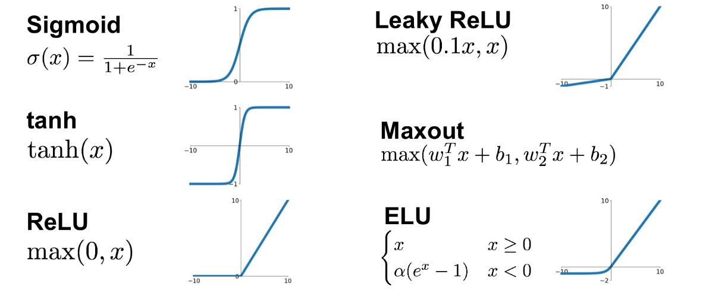
Theory Activation functions

Slide 22
Notebook Break
Now that you understand the concepts behind getting results from a neural network, go onto to the jupyter notebook and read through some of the articles to understand how feeding forward works in a neural network (with multiple layers)

Slide 23
Backpropagation
Now that we understand how the weights affect the output. How do we effect the weights based on the output? This is where backpropagation comes in. We will walk through a basic 1D example then later on, explain how the same concepts can be used for complicated networks.
N₀
W₀
N₁
W₁
N₂

Slide 24
Backpropagation
1. Multiplication
2. Summation
3. Activation
σ (I₀ * W₀)
N₀
W₀
N₁
W₁
N₂

Slide 25
Backpropagation
1. Multiplication
2. Summation
3. Activation
σ ( σ (I₀ * W₀) * W₁)
N₀
W₀
N₁
W₁
N₂

Slide 26
Backpropagation Error
Our expected output is denoted as y. We will use the squared error as our cost function. Therefore our error will be equal to what the squared difference between our model prediction and our target.
J = (y’ – y)²
y’ = σ ( σ (I₀ * W₀) * W₁)
N₀
W₀
N₁
W₁
N₂
I₀
σ (I₀ * W₀)
σ ( σ (I₀ * W₀) * W₁)

Slide 27
Backpropagation Updating weights
Each weight has had some effect on the output. We need to figure out how responsible each weight was for the error. This will tell us what to update the weight to. To figure out these ‘responsibility’ values, we can use calculus.
J = (y’ – y)²
y’ = σ ( σ (I₀ * W₀) * W₁)
N₀
W₀
N₁
W₁
N₂
I₀
σ (I₀ * W₀)
σ ( σ (I₀ * W₀) * W₁)

Slide 28


Backpropagation Updating weights
Lets formalise the equations we want to solve
N₀
W₀
N₁
W₁
N₂
I₀
σ (I₀ * W₀)
σ ( σ (I₀ * W₀) * W₁)

Slide 29
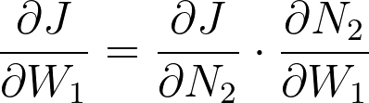
Backpropagation Calculus
Let’s solve w1 since this is requires less steps. Using the chain rule we can simplify what we have to solve.
N₀
W₀
N₁
W₁
N₂
I₀
σ (I₀ * W₀)
σ ( σ (I₀ * W₀) * W₁)

Slide 30
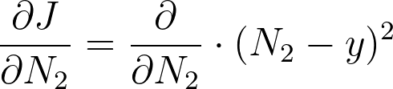
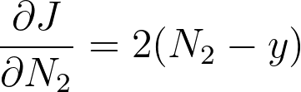
Backpropagation Calculus
Expanding what we have to solve.
N₀
W₀
N₁
W₁
N₂
I₀
σ (I₀ * W₀)
σ ( σ (I₀ * W₀) * W₁)

Slide 31
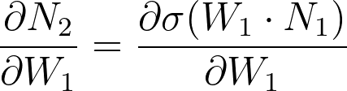
Backpropagation Calculus
Expanding what we have to solve.
This isn’t straightforward, so lets break this down more
N₀
W₀
N₁
W₁
N₂
I₀
σ (I₀ * W₀)
σ ( σ (I₀ * W₀) * W₁)

Slide 32
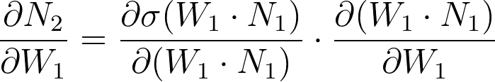
Backpropagation Calculus
How do we find the derivative of the sigmoid function?
N₀
W₀
N₁
W₁
N₂
I₀
σ (I₀ * W₀)
σ ( σ (I₀ * W₀) * W₁)

Slide 33
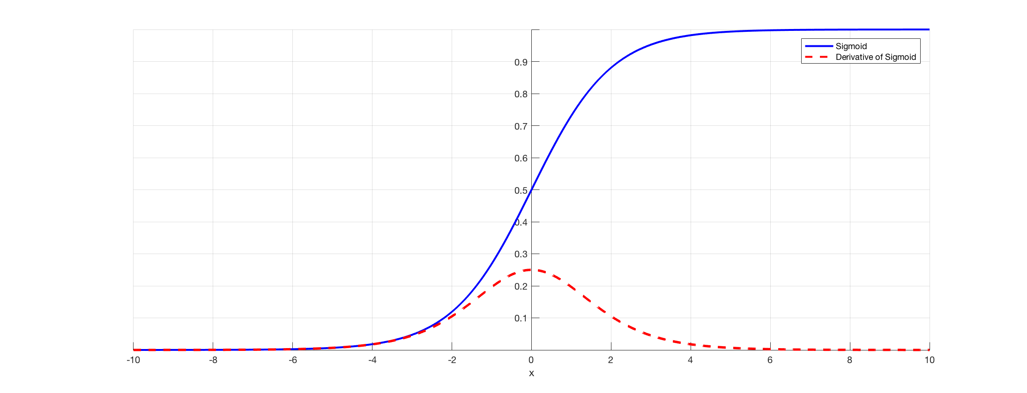

Backpropagation Calculus

Slide 34
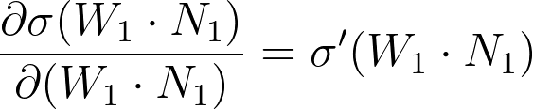
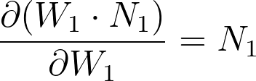
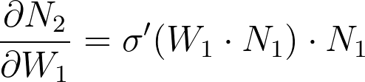
Backpropagation Calculus

Slide 35
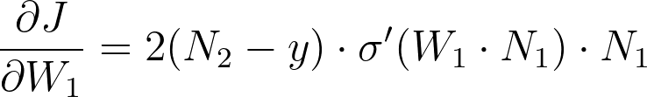
Backpropagation Calculus

Slide 36
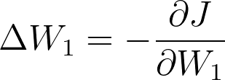
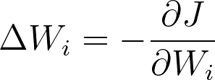
Backpropagation Calculus
This translates into an update rule for the respective weight.
The same principles apply for other weights.

Slide 37
Notebook Break
Now that you understand how to update weights go over to the jupyter notebook and we will look at creating a neural network that will learn to solve a simple task.

Slide 38
Beyond simple networks
As far as more complicated networks go, the principles of feeding forward and backpropagation remain the same.
Deep neural networks are the same as NN but with multiple hidden layers, this brings rise to more complex relation (bear in mind this takes longer to train).
There are a whole host more neural network structures (LSTM, CNN, GAN).

Slide 39
Recap
The theory behind neural networks
The basic perceptron
Feeding forward
Backpropagation
Coding a neural network

Slide 40
Thank you
Jasamrit R
JRahala

